Slide 1

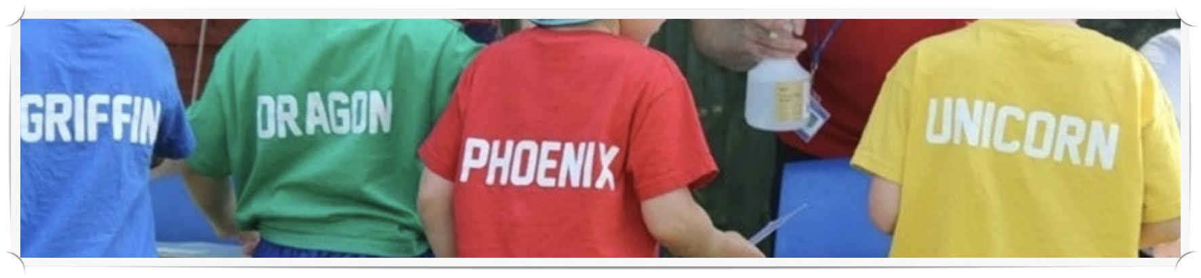
Welcome to Long Lane Primary School
Jude
Jude

Slide 2

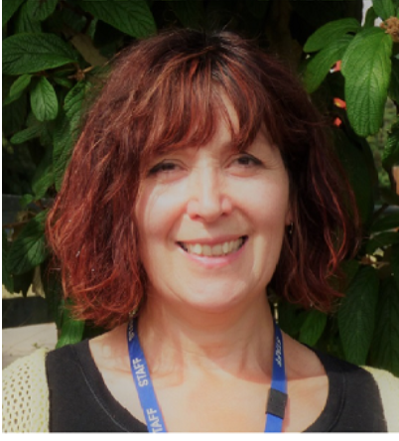
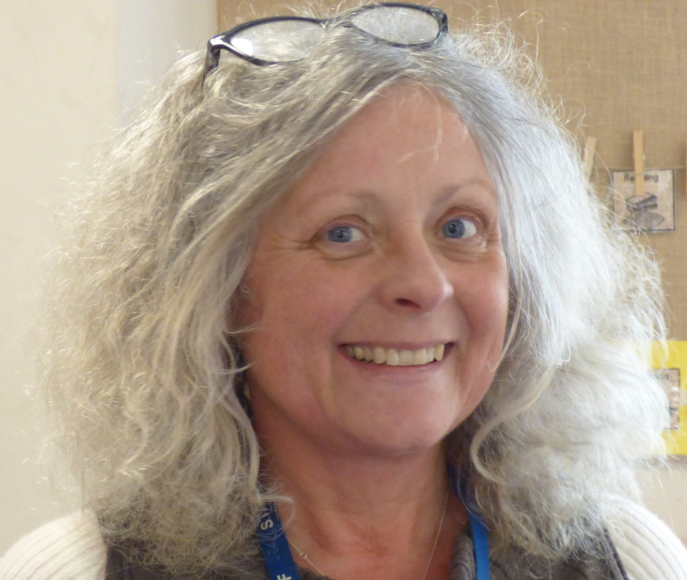


  Your child will be joining
  Rainbow Class
  in September 2025
  Your child’s teachers will be
  Miss Penn &
  Mrs Whitehall

Slide 3
Welcome to Long Lane Primary School
At Long Lane we strive to make the transition into school as supportive as possible. We believe that working in partnership with parents is vital to fully support each child’s learning and development.
This welcome pack will outline our plans for transition as we prepare for your child to start school in September. It also contains some guidance to help with supporting your child's learning during their first year of school.
Getting to know you
During the summer term we will be contacting pre-schools and nurseries to help us learn more about your child and to arrange to visit your child at their pre-school setting where possible.
On Wednesday 11th June from 6-7pm, you are invited to a Welcome Evening for parents where you can meet staff and visit the Foundation Stage learning environment. We would ask that children do not come to this event.
On the morning of Wednesday 23rd July, we would like to invite your child to one of two 'stay and play' sessions so that they may become more familiar with the setting environment and some of the class routines. Timings for these are 9-10am and 10.30-11.30am.
On Thursday 4th or Friday 5th September, you and your child will be invited to visit the setting, to explore together and have a 15 minute meeting with Miss Penn. We will arrange appointments for this during the Welcome Evening. Home visits will be offered to families new to the school during the first days of term and can be booked at the Welcome Evening.
We will provide you with a ‘Day in Rainbow Class’ pack to use with your child, which will help to familiarise them with their new school.

Slide 4

Starting school- dates and times
All children will start school on Monday 8th September.
Initially the school day will be shorter, finishing at 1:20pm for the first 2 weeks. This will enable classroom staff to support your child during their lunchbreaks. For the first 3 days, starting times will be staggered to allow children to come into school and put their things away without it being too busy. We will allocate you a start time of 8.45, 9.00 or 9.15am. We appreciate that this phased start can be inconvenient for some working parents, but we are sure that you will understand the benefits of a positive transition process at this important time.
For some children, it is more suitable to start school part-time and build up to full time attendance over a longer period. This may be the case for a child who has not already attended a pre-school setting on a full-time basis, has a medical need meaning that they would benefit from a shorter school day, or is not thought to be ‘school ready’, for example, able to use the toilet by themselves. The class teacher will discuss this with parents on an individual basis.
https://cypf.berkshirehealthcare.nhs.uk/health-and-development/independence-and-school-readiness/
https://www.longlane.w-berks.sch.uk/index.php/starting-school

Slide 5

Daily Routines – dropping off and picking up
Please bring your child to the Rainbow Class entrance via the main gate and through the playground.
After an initial settling period, we ask that adults please wait at the bottom of the ramp and encourage your child to come in to class independently. Classroom staff will be available to help them in and to put their things away.
Once the transition period has finished and children are attending for full days, children come in to school from 8.45am when the door is opened. The school day starts at 8.55am and children should be in by this time. School finishes at 3.15pm. . Children are collected from the classroom at the end of the school day. Please wait at the bottom of the ramp to collect your child.
If someone new is collecting your child from school, please tell the teacher in the morning or contact the office.
We are very keen to learn about important events in your child’s life and it is important to discuss any concerns or issues which may affect your child. Short messages may be passed on in the morning, longer messages or enquiries can be sent by email to the school office at loffice@longlane.w-berks.sch.uk Urgent messages during the school day should be by telephone to the school office (0118 942 7187).
The playground gates close at 8.55 each morning. If you are late bringing your child to school in the morning, please go to the school office. The office staff will then bring your child to the classroom. Children arriving after 9am are recorded as ‘late’ in the register unless this is due to an appointment or medical reason. Please try to establish a morning routine which enables your child to get to school on time as they may miss out on important learning otherwise.
Sometimes, unexpected events are unavoidable. In the event of you being late to collect your child in the afternoon, please phone the school office to let us know. If you would like someone else to collect your child, you must let us know beforehand. If the playground gates are closed when you arrive, please go to the main office.
In the event of illness, please inform the office staff first thing in the morning, either by telephone or via the Absence Reporting facility on Parentmail. Telephone number: 0118 942 7187. If your child has diarrhoea or vomiting, they must remain at home for 48 hours after the last incidence, as per NHS guidance.

Slide 6

Lunches, snacks and drinks
Children may bring a healthy packed lunch from home (no fizzy drinks or sweets please) or have a lunch provided by school. You will be provided with a copy of the lunch menu and lunches should be ordered at home using Parentmail. School lunches are free for all children in Reception, Year 1 and Year 2.
There is a ‘School Fruit and Vegetable Scheme’ whereby all children up to the age of seven are provided with a piece of fruit or vegetable free of charge each day. Crackers and breadsticks are also available from the Rainbow Class Snack Bar. However, if you would like to provide your child with an additional snack you are welcome to do so.
This should be a healthy snack such as a piece of fruit or vegetable (fresh or dried).
Biscuits, cake, crisps and chocolate etc. are not permitted. Grapes should be cut in half lengthwise to avoid them being a choking hazard.
All snacks should be in a named bag or box which your child can open themselves.
Free milk is available to under-fives. Once your child is five, milk can be purchased from ‘Cool Milk at School Ltd’ (see attached details).
It is school policy that children have access to water throughout the day. Please provide your child with a named water bottle. These should contain water only.

Slide 7



Preparing for school
Starting school is an important step in your child's social development and independence. Discover ideas, information and activities within the toolkit sections of the Pacey website and find out more about preparing your child so that they are ready to start school with a smile in September.
Here are some other ways you can help your child to prepare for school:
Practice independent toileting and handwashing
Practice dressing and undressing themselves independently
Spend time talking and listening to your child, can they they hold a conversation? Encourage your child to speak in sentences.
Develop motor skills e.g. throwing, batting and catching a ball, climbing, swimming, painting and chalking large shapes, drawing pictures and writing their name. Encourage your child to write in lower case letters, only use capital letters to start a name or sentence – see letter formation guidance.
Share books and read stories to your child, encourage your child to describe what they see in the pictures. What do they think will happen?
Sing nursery rhymes and number rhymes together https://www.bbc.co.uk/teach/school-radio/nursery-rhymes-counting-songs/zn67kmn
Enjoy turn-taking activities and games
Complete jigsaw puzzles and construction activities - duplo, marble run etc
Count – anything! Pebbles, pencils, steps, fingers, pasta shapes, cars…
Spot numbers in the environment around you e.g. door numbers, numbers on buses etc.
Play matching and memory games
Identify shapes and colours - can your child spot a circle? Can they describe it? Try sorting toys into different colour groups.
Become familiar with letter sounds (not names yet) - https://www.youtube.com/watch?v=TkXcabDUg7Q We will include a phonics pack for you to share with your child.

Slide 8


School Uniform in Rainbow Class
To support your child’s growing independence, our uniform for children in Foundation Stage is different from the rest of the school.
We ask that our Foundation children wear clothes which are appropriate for the active curriculum they follow. This will also enable them to manage changing and toileting independently with greater ease. Most uniform items can be purchased in high street shops. Printed house T-shirts are available from Price & Buckland.
The uniform for Foundation Stage pupils is as follows:
Navy blue sweatshirt or zip up hoodie- sweatshirts should be large enough for children to easily put on and take off independently (this does not need to have the school logo)
House colour T shirt – these can be printed with house name
Navy blue joggers
Royal or navy blue pull on shorts
Dark grey or white socks
Black velcro-fastening shoes or trainers suitable for active outdoor play (not plimsolls please)
A spare set of clothes & trainers should be provided in a named bag and kept in school all week. All clothing and footwear must be clearly labelled with your child’s name.
The Rainbow Class uniform is identical to the KS1 and KS2 PE kit so may be re-used in Year 1.

Slide 9

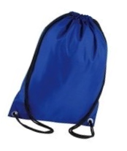
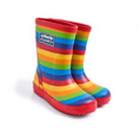


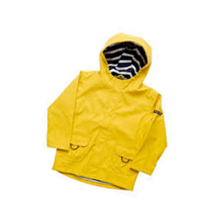
Other useful equipment
All children should have a slim book bag (not a rucksack please). This does not need to have a school logo but must be named. Some families attach a keyring for easy identification. Please just add one!
A drawstring bag will be useful for a spare set of uniform & trainers.
Learning outdoors is a very important part of our school day. The children have access to the garden even when it is raining, providing they have a waterproof jacket with a hood, and wellington boots. It would be helpful if your child could keep a waterproof jacket or puddlesuit and wellingtons in school at all times. The children will also need these for the forest school sessions along with a pair of gloves. For sunny days, a sun hat or cap will be needed. Sunscreen should be applied at home before school and not sent into school.
Please ensure that everything brought into school is clearly named. This applies to all school uniform, shoes, bags, water bottles and lunch/snack boxes.

Slide 10
Hair, make up and jewellery at Long Lane
For hygiene and safety reasons, please keep long hair tied back or plaited, hair accessories should be discrete and preferably in neutral or school colours. Extremes of hair fashions are not appropriate for school, words or symbols cut into hair will not be acceptable within the school.
Our school champions the right of staff and students to embrace all Afro hairstyles. We acknowledge that Afro-textured hair is an important part of our Black staff and students’ racial, ethnic, cultural, and religious identities.
Make-up, including nail varnish, is not permitted at school.
Due to the physical nature of play and learning in Early Years, it is preferable that children do not wear a watch or any jewellery to school while they are in Foundation Stage. ​

Slide 11
The Early Years Foundation Stage (EYFS) Curriculum
Your child's learning progress and development will be tracked against the Early Learning Goals, as described in the EYFS curriculum. Their progress will be shared with you at parent meetings throughout the school year and in their end of year report in the summer term.
Our Foundation Stage curriculum at Long Lane is inspired by seasonal changes, our local environment and children's interests. We have selected a diverse range of stories and non-fiction texts with linked activities which help to make learning memorable and engaging.
The Statutory Framework for Early Years Foundation Stage (EYFS) was revised for 2021 and sets standards for an integrated approach to the learning, development and care of children from birth to 5 years old, including the reception year of school. All school reception classes must follow the EYFS Framework.
Young children learn best through play. The EYFS recognises the importance of play, direct experiences and active learning to support young children's learning effectively.
The EYFS curriculum is grouped into 7 areas of learning and development:
3 prime areas - Communication and language, Physical development, Personal, social and emotional development
4 specific areas - Literacy, Mathematics, Understanding the world, Expressive arts and design
The Development Matters guidance shows how the four themes of the EYFS Framework and the principles that inform them work together to support babies and children. The Unique Child develops and learns through interaction in Positive Relationships and Enabling Environments. It gives examples of how the Characteristics of Effective Early Learning can be supported and developed by adults and how integral they are to all the areas of learning and development.
Please click on the links to visit the documents and find out more.

Slide 12


Phonics and learning to read
We want all children to leave Long Lane with effective literacy skills, ready for their next stages of education. Most children love listening to stories and sharing books with their parents. It is important to nurture this love of books and for children to understand that meaning is gained from pictures and print. When your child first starts school, they will be encouraged to borrow a ‘sharing book’ from the class library each week.
Children develop at different rates with some ready to start reading earlier than others. We assess your child’s level of understanding and build on their achievements so far. Daily reading practice at home makes a big difference to a child’s rate of progress when learning to read. We will hold a workshop during the autumn term to give you more information in supporting your child as they learn to read.
At Long Lane we systematically teach phonic skills using the Read Write Inc. phonics scheme. During their first half term in reception, children will begin short daily phonic lessons to start learning the Set 1 sounds and to begin blending these to read simple words. By the end of the first term of reception the children are grouped by ability for these sessions, which will form the basis of their reading and writing development throughout reception and Year 1.
You can find out more by visiting our school website www.longlane.w-berks.sch.uk
Read Write Inc. https://www.ruthmiskin.com/en/find-out-more/parents/
Oxford Owl https://home.oxfordowl.co.uk/
Children learn letter sounds first and letter names later. Initially your child will bring letter sounds home to practise (eg a-a-a apple). You are encouraged to play games with the letter sounds eg. searching for things beginning with that sound, or sounding out words for your child to blend – you say d-o-g, your child says 'dog'. Once children are beginning to blend sounds to read words, they will have sets of words or reading books to practise at home.
Home reading books will be linked to the phonics learning your child is doing in school. Help your child to practise saying letter sounds and blending them to read the words. Rereading these books will help your child to develop confidence in decoding and blending using the letter sounds they have learnt. When your child becomes more confident with blending, they will be able to read words without saying the sounds first.
Please sign and write a short comment in the reading record book each day, when you share a book or hear your child read. Please note down anything your child did well or what they found tricky. We would like you to spend time reading with your child every day.

Slide 13

Learning to write
Children need to develop gross and fine motor skills before they can successfully write. Many of our classroom activities (e.g. bead threading, play dough, peg boards, painting, jigsaws etc.) are designed to help develop the muscles which are essential for writing skills. Activities such as swimming, climbing and ball games help develop gross motor skills and can support your child’s physical development and will also make writing easier.
When children first start to mark-make independently, they usually do ‘pretend’ writing. We encourage this and provide opportunities for children to write in 'code' to encourage freedom in their mark-making. Try asking your child to tell you what their writing says! Gradually, recognisable letters will appear in their writing, followed by letters which relate to the words they are trying to write. We encourage children to listen to the sounds in words and ‘have a go’ rather than worrying about making a mistake. Accuracy will come with time and developing the confidence to write is very important at this stage.
We teach letter formation following the Read Write Inc. Phonics scheme and the Nelson handwriting programme. Children are taught to say the word they want to write, finding the sounds using their 'Fred' fingers to help their recall. A sample of the letter formation we use in school is included in the phonics pack. Please show your child how to form letters correctly, starting and finishing in the correct place. This will really help later (in Year 1) as your child learns to join their handwriting. When writing for your child, or encouraging them to write their name, please use lower case letters except for an initial capital letter.
It is very important to encourage an effective pencil grip when your child starts to write (see guidance enclosed).

Slide 14

Helping in school
We appreciate any time that you can give to help out in school. If you would like to volunteer to help the children to change their class library books, or to support with other aspects or learning, please speak to Miss Penn, Mrs Whitehall or contact the school office.
Please help your child to make a treasure box over the holidays and fill it with 5 things which are important to them, for example, a baby photo and a favourite toy. Encourage your child to tell you why each item is important to them. During their first days at school, they will talk to the other children about their treasure for their first show and tell. Please bring the treasure box when your child first starts school. Please also include a family photograph which can be displayed in the Rainbow Class Gallery when they start school.
We are really looking forward to welcoming you to Long Lane and Rainbow Class. We realise that there is a lot of new information here. If you have any questions or are unsure about anything at all, please contact our school office:
0118 942 7187
loffice@longlane.w-berks.sch.uk
Thank you
☺
Summer holiday task

